Slide 1

WSO2 API Manager 4.2.0 Developer Advanced
Building a CI/CD Pipeline for APIs
WSO2 Training

Slide 2
Discussion Topics
Driving towards automation
Automation challenges in API Management
Deciding CI/CD strategy
Technology and Tooling support
Building simple CI/CD pipeline with WSO2 API Manager

Slide 3
Building CI/CD Strategy

Slide 4

Building CI/CD Strategy
Organizations follows variant strategies
First step of building a CI/CD process associates with
Organization culture
Governance structure and process
Team structure and dynamics

Slide 5
Importance of CI/CD in API Management
APIs are the de facto standard for connecting services, data and apps
APIs are the pumping fuel of digitally driven organizations
Rapid phase of API development
Smooth propagation of APIs between environment is critical
Ensure the functionality upon update across environments is important for the quality aspects

Slide 6
Why CI/CD in API Management?
Rapid development and deployment of APIs
Less human interruptions
Fast delivery to end users
Time saving and efficiency gain
Automated process provide greater management flexibility
Detect issues earlier

Slide 7
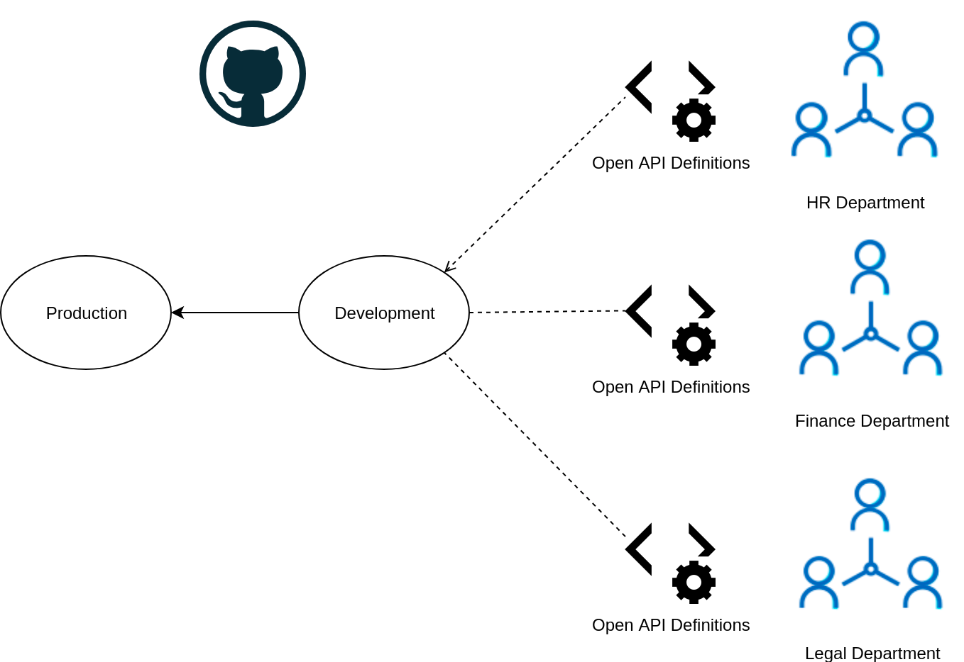
Automation Challenges

Slide 8
Automation Challenges
Organizations are maintaining multiple deployment environments
APIs associate with multiple policies and configurations
Environment specific (endpoints) configurations
Interference with multiple development teams

Slide 9








Automation Challenges
Technology and tooling plays a vital role in the CI/CD process implementation
Selection of process automation tool
Jenkins
Travis CI
TeamCity
Circleci
Drone
Selection of source code repository
Github
Gitlab
Bitbucket

Slide 10
Support from API Management Vendor
CI/CD approach of each API Management vendor is different
API Vendors offer
Tooling support
Support for Interaction with source code repositories
Extensions to configure environment specific configurations
Plugins and extensions for pipeline tools
Standard REST APIs

Slide 11
Configs that Differ Between Environments
APIs contain environment specific configurations
Some of the configurations differ between environments
Environment-specific configurations include
Backend endpoints
Credentials of backend services
Certificates of endpoints
Endpoint timeout settings
Gateway environments

Slide 12
CI/CD with WSO2 API Manager
Selection of process orchestration tool such as Jenkins is a key requirement
CI/CD process requires a Source Code Management(SCM) system which acts as a Single Source of Truth for the pipeline
apictl tool of API Manager provides the flexibility to integrate with these tools to migrate APIs between environments
It is capable of handling environment specific configurations and can promote the API seamlessly to other environments via a single command

Slide 13
API Controller (apictl)

Slide 14
apictl and its Features
Platform Agnostic
Inject environment related configurations
Command Line tool
Easy configuration with many CI/CD tools

Slide 15
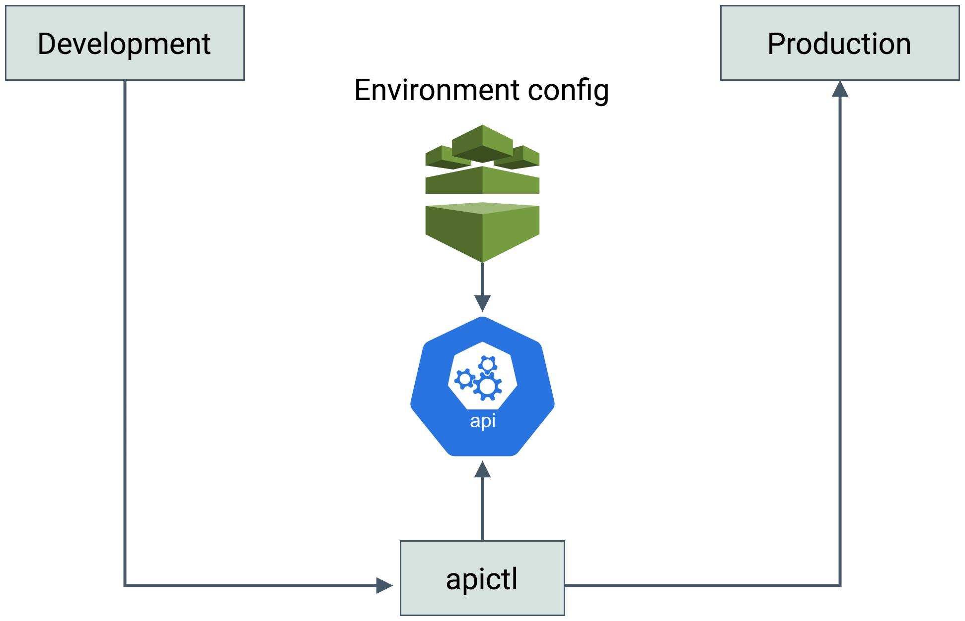
Simplistic View

Slide 16
CI/CD for APIs - Using the CLI

Slide 17
Building Blocks for Creating a CI/CD Pipeline with CLI
Prepare the environments
Generate the API project
Commit API project and deployment resources to a VCS for CI/CD
Import the API to an upper environment

Slide 18
Preparing the environments
Install APIM-4.2.0
Install apictl-4.2.0 and configure
Refer …
Generate the API project
Create an API via API Publisher in a lower environment and export via apictl
or
Initialize the project using a Swagger/OpenAPI specification
Refer [1]. [2], [3]

Slide 19
Commit API project and deployment resources to a VCS for CI/CD
Copy the created/exported API project into the Source repository
Generate the deployment artifacts directory for the API project to define the environment-specific details for the API
Commit the changes to the version control system.
Refer …

Slide 20
Import the API to an upper environment
The Automation Server can be configured to run a specific pipeline for promoting artifacts to other environments.
apictl tool is used for this
Refer …

Slide 21
Extending a CI/CD pipeline for additional operations

Slide 22
Extending a CI/CD pipeline for additional operations
Using apictl in order to invoke an API or an API Product by subscribing to it using a new application created by apictl. [Refer]
Extending a CI/CD pipeline to support API Products [Refer]
CI/CD pipeline can support API products other than APIs
The commands used are somewhat different and also a project for API product cannot be created using an OpenAPI definition.
Extending a CI/CD pipeline to support applications [Refer]
Can use this CI/CD approach to export applications from lower environments to upper environments.

Slide 23
Building a CI/CD Pipeline for APIs using Jenkins

Slide 24
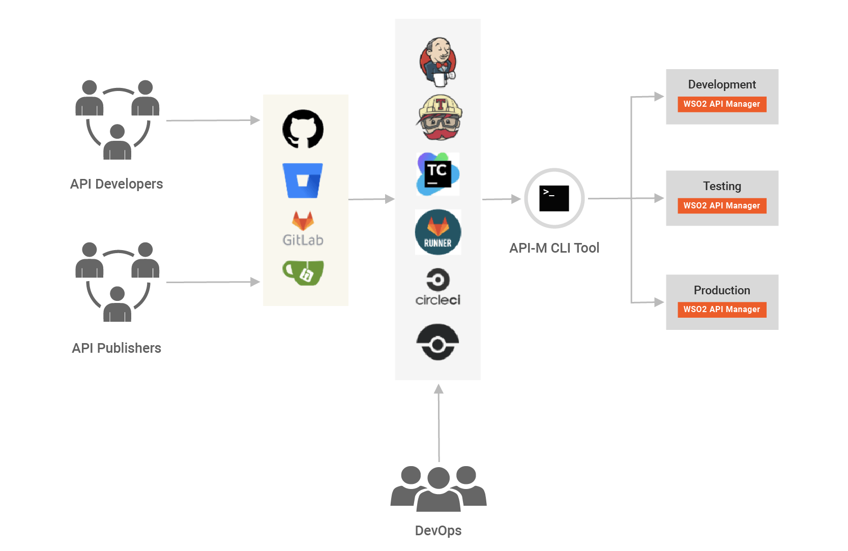
CI/CD Process Overview
apictl

Slide 25
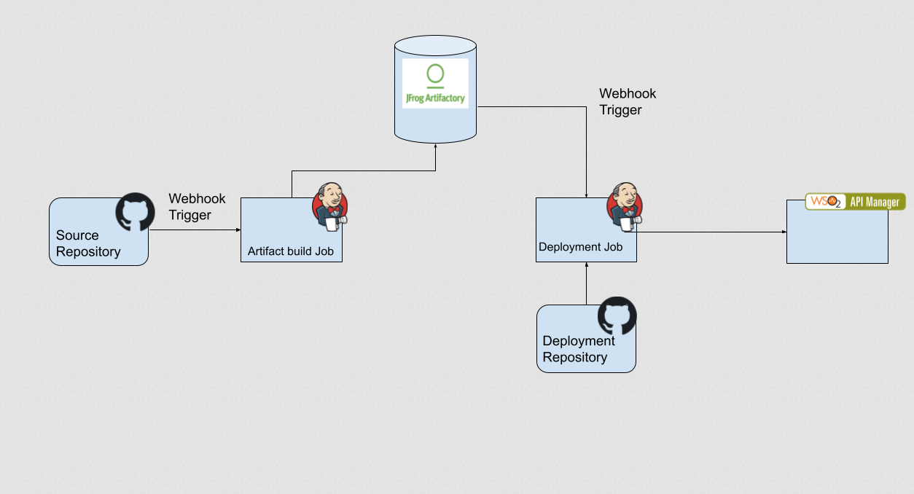
Use case Overview

Slide 26
Building Blocks for Creating a CI/CD Pipeline
Setup Jenkins and apictl tool
Create GitHub repositories
Setup JFrog Artifactory
Setup API-M instances
Configure Jenkins Jobs

Slide 27
Setup Jenkins and apictl tool
Use a remote machine that has public access
Install jq
Install the apictl tool
Install Java
Setup the Jenkins server
Note: apictl add-env command has been deprecated from apictl 4.0.0 onwards. Instead use apictl add env as shown above.
Set up Jenkins

Slide 28
Create GitHub repositories
Setup source repository
Configure to trigger a Jenkins job when a change is made to the repository.
Setup deployment repository
To gather configurations for each deployment.
Create GitHub repositories

Slide 29
Setup JFrog Artifactory
This will be used to upload and maintain artifacts
Need to configure accessibility, users and create a repository.
Configure a webhook to trigger a Jenkins job which will be triggered and perform API deployment task.
Setup JFrog Artifactory

Slide 30
Configure Jenkins Jobs
Setup Global variables required to link to the APIM instance and Artifactory repo.
Setup Artifact build and upload job
listen to any change in the source repository and perform a build and upload any new update to the artifactory repository
Setup Artifact deployment Job
listen to new updates in the artifactory repository and deploy the artifact with the configurations in the Deployment git repository to the dev API-M environment.
Configure Jenkins Jobs

Slide 31

Let’s try it out!
Validating the WSO2 API Manager Environment
Building a Jenkins CI/CD pipeline with API Controller
Building a CI/CD pipeline with GIT

